Slide 1
InsightUBE

Slide 2
Problem statement
Develop an AI-based video analysis tool that can help YouTubers optimize their video content for higher engagement and more views

Slide 3
Objective
The objective is to create a solution that can help YouTubers grow their audience and improve their content quality.

Slide 4
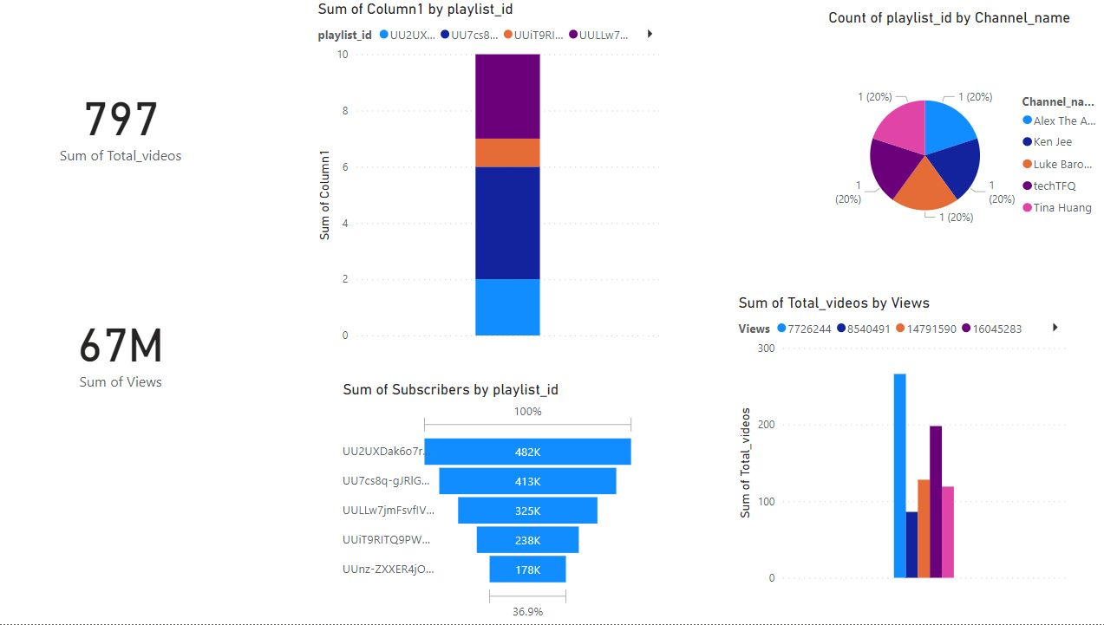
Dashboard

Slide 5
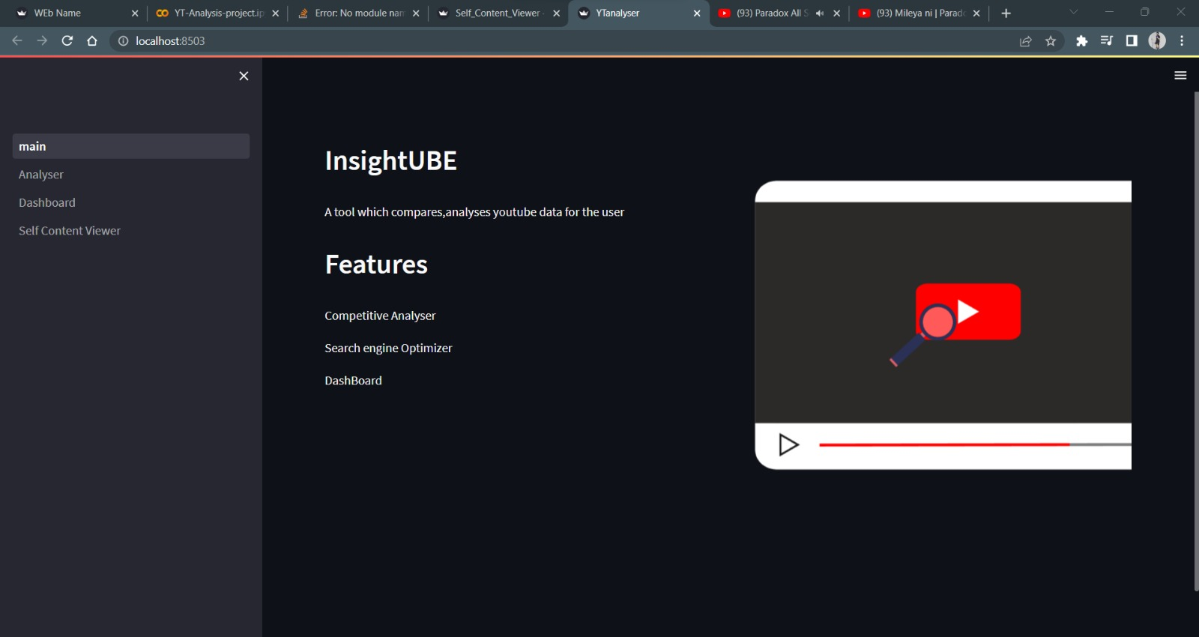
Landing Page

Slide 6
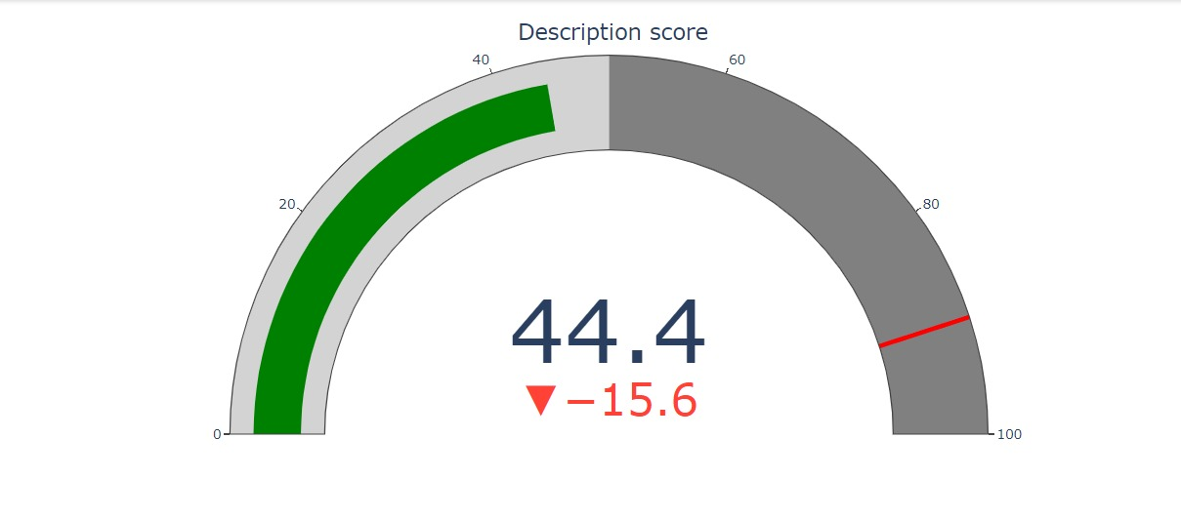

Slide 7
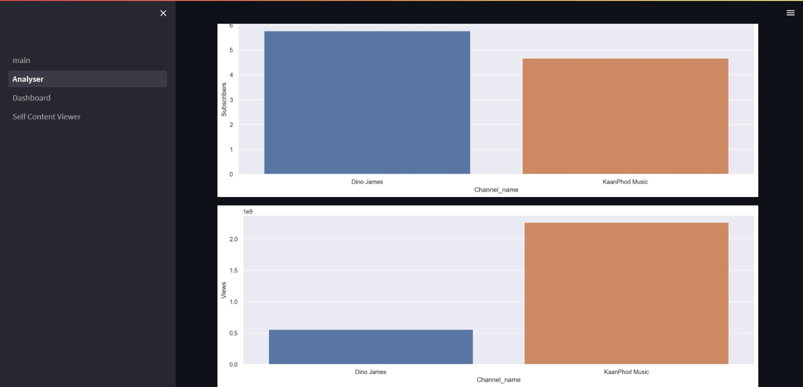

Slide 8
